Slide 1




VOICE BASED EMAIL SYSTEM FOR DISABLED PERSON
BATCH NO A13
HEMAVARSHINI D (132)
PHOOJA SHREE R (156)
GUIDE : Dr. SUDHA
ASSISTANT PROFESSOR

Slide 2

INTRODUCTION
Artificial Intelligence, the ability to design smart machines or to develop self-learning software applications that imitate the traits of the human mind.
Thus this system enabling everyone to control their mail accounts using their voice only and to be able to read, send, and perform all the other useful tasks.
The main benefit of this system is that the use of keyboard is completely eliminated, the user will have to respond through voice only.

Slide 3
ABSTRACT
This application uses the similar function of the email bot for speech recognition to send and receive the mail.
But this is especially for blind people who cannot understand what is it and how to access it.
Here, pyaudio packages are used for voice based mail sending and receiving.
SMTP and IMAP protocol are used for speech-to-text and text-to-speech conversion respectively

Slide 4
LITERATURE SURVEY
TITLE | AUTHOR | ABSTRACT | YEAR OF PUBLISHING
A voice based text mail system for visually impaired | Carmel Mary Belinda MJ, Rupavathy.N , Mahalakshmi N R | The voice Activation Detection API is used to convert our audio in to text. The system also speaks i.e., response to user accordingly. This is done by using Answer Activation detection (Phonics decoding) | February 2018
MERITS
DEMERITS
This EMAIL system can be used by a blind
person to access mails easily and efficiently.
There are two major drawbacks in
this application i.e.., the exact voice recognition and the image or
document attachment.
Link: https://www.researchgate.net/publication/324526106_A_voice_based_text_mail_system_for_visually_impaired

Slide 5
LITERATURE SURVEY
TITLE | AUTHOR | ABSTRACT | YEAR OF PIBLISHING | MERITS | DEMERITS
Voice based email system for blinds | Diksha Kumari, Nisha Pai, Parul Jha, Pratmika Nayak | We aim to overcome the shortcomings of the existing system in making the user completely independent with our proposed system. | April 2017 | One of the major advantages of this system is that for the most part, the user won’t require the use of keyboard. All operations will be based on mouse click events. | The wave module provides a convenient interface to the WAV sound format. It does not support compression/decompression, but it does support mono/stereo.
Link:https://ieeexplore.ieee.org/document/9596293

Slide 6
LITERATURE SURVEY
TITLE | AUTHOR | ABSTRACT | YEAR OF PIBLISHING | MERITS | DEMERITS
Controlling Email System Using Audio with Speech Recognition and Text to Speech | Harsh D Shah, Amit Sundas, Shabnam Sharma | This paper is based on methodology and Architecture of voice interaction starting from sender name, subject and body of email which makes it audio controlled email bot. | 15 November 2021 | Easy to send the mail to receiver without using gmail (compose) | Can only compose the mail but can’t read the mail that is received
Link:https://ieeexplore.ieee.org/document/9596293

Slide 7
LITERATURE SURVEY
TITLE | AUTHOR | ABSTRACT | YEAR OF PIBLISHING | MERITS | DEMERITS
Voice-Based Email System | Harivans Pratap Singh,Aman Pratap Kushwaha, Aayushmaan, Harendra Singh | This system enabling everyone to control their mail accounts using their voice only and to be able to read, send, and perform all the other useful tasks | 7, July 2021 | Hash algorithm is used in this application in checking the validate of database. | Even though the keyboard is eliminated the user have to know the mouse click
LINK:https://ijisrt.com/assets/upload/files/IJISRT21JUL1171.pdf

Slide 8
PROMBLEM STATEMENT
The project is a python-based application for visually impaired persons using speech to text voice response.
This voice based email system has great application as it is used by blind people as they can understand where they are.
This is because in order to access the internet one would need to know what is written on the screen. If that is not visible it is of no use to access the email.
This system focuses more on user friendliness of all types of persons including regular persons, visually compromised people as well as illiterate.
Notes:
When conducting research, it is easy to go to one source: Wikipedia. However, you need to include a variety of sources in your research. Consider the following sources:
Who can I interview to get more information on the topic?
Is the topic current and will it be relevant to my audience?
What articles, blogs, and magazines may have something related to my topic?
Is there a YouTube video on the topic? If so, what is it about?
What images can I find related to the topic?

Slide 9

DEVELOPMENT ENVIRONMENT
HARDWARE REQUIREMENT
System : i5
SSD : 512
Speaker : Realtek(R)Audio
RAM : 8GB
SOFTWARE REQUIREMENT
Operating system : Windows 11
Coding language : Python

Slide 10

SYSTEM ARCHITECTURE
COMPOSE
SPEECH RECONGNATION
INBOX
USER INPUT
REGISTRATION &
LOGIN
SYSTEM SPEAKING
GOOGLE ASSISTANT
SMTP PROTOCOL
MAIL COMPOSING
PRE-KNOW MAIL
STT
VALIDATE
MAIL LIST
IMAP PROTOCOL
MAIL INBOX
TTS

Slide 11
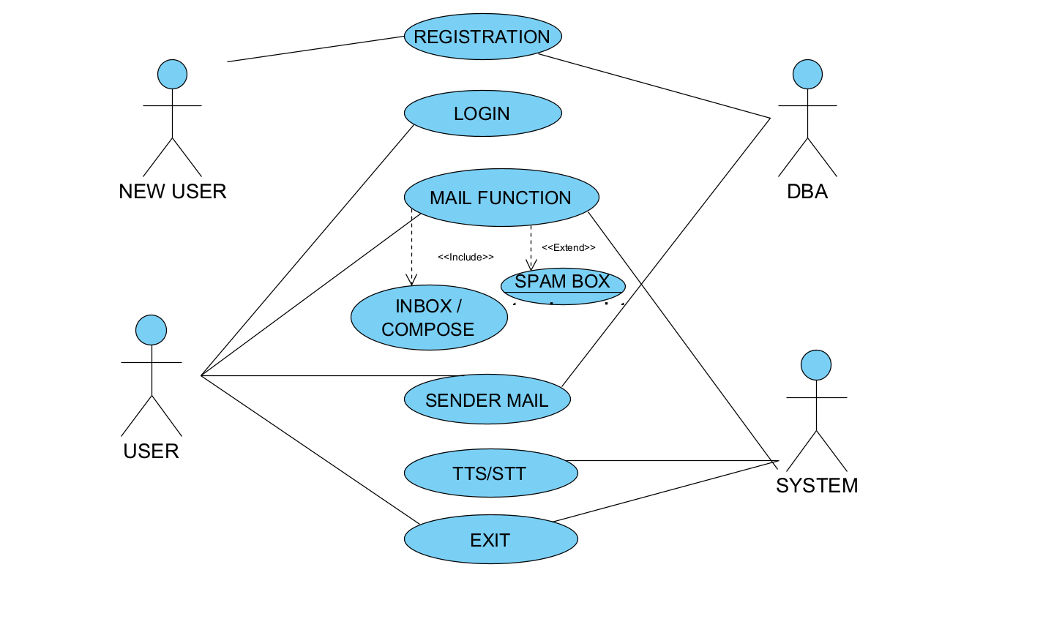
SYSTEM DESGIN-USE CASE

Slide 12
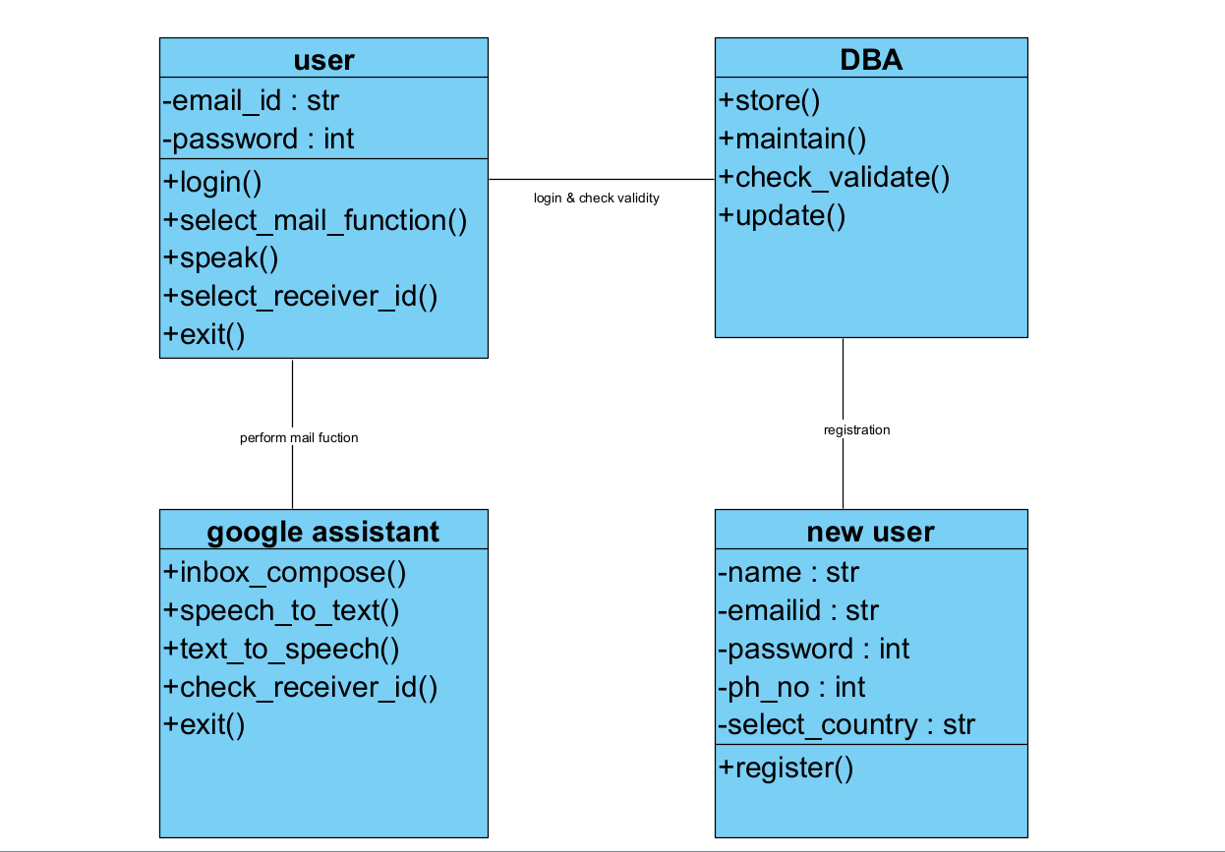
SYSTEM DESIGN-CLASS DIAGRAM

Slide 13
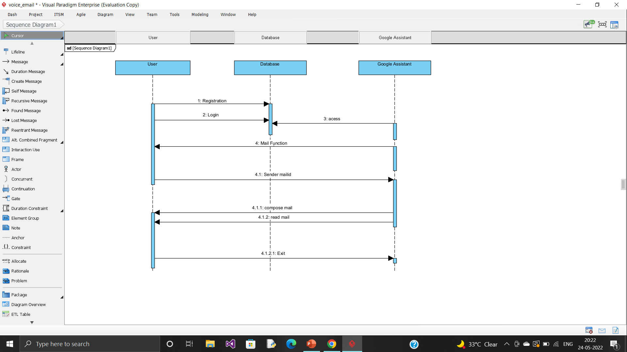
SYSTEM DESIGN – SEQUENCE DIAGRAM

Slide 14
EXISTING SYSTEM
Unfortunately, the existing system is not supported, as there is no voice command or sound system
It is difficult for visually challenged person to send mail to others.
Even if the current Browser can playback audio and video files, the user needs to make a query by typing in the text and then decide for themselves to enable users to playback audio and video files with the help of the Graphical user interface (GUI)

Slide 15
PROPOSED SYSTEM
So in this system we use voice recognition such as Google assistant.
Google assistant is an artificial intelligence–powered virtual assistant developed by google that is primarily available on mobile and smart home devices.
Importing the packages
SMTP Protocol
IMAP Protocol
Pyttsx3
Speech recognition
TTS and STT conversions( Text-to-speech and speech-to-text systems are accessible)

Slide 16

SYSTEM MODULE
This voice based email system is the great application as used by blind people to understand how emailing can be performed.
Registration
Login page
Mail page
Inbox
compose
Notes:
Once you find your sources, you will want to evaluate your sources using the following questions:
Author:
Who is the author?
Why should I believe what he or she has to say on the topic?
Is the author seen as an expert on the topic? How do you know?
Current:
How current is the information in the source?
When was the source published?
Is the information out-of-date?
Accuracy:
Is the content accurate?
Is the information presented objectively? Do they share the pros and cons?

Slide 17
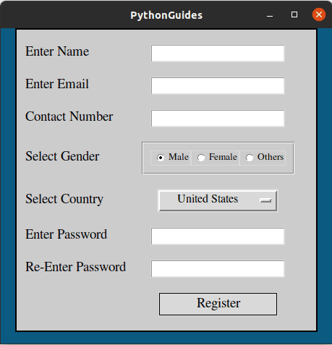
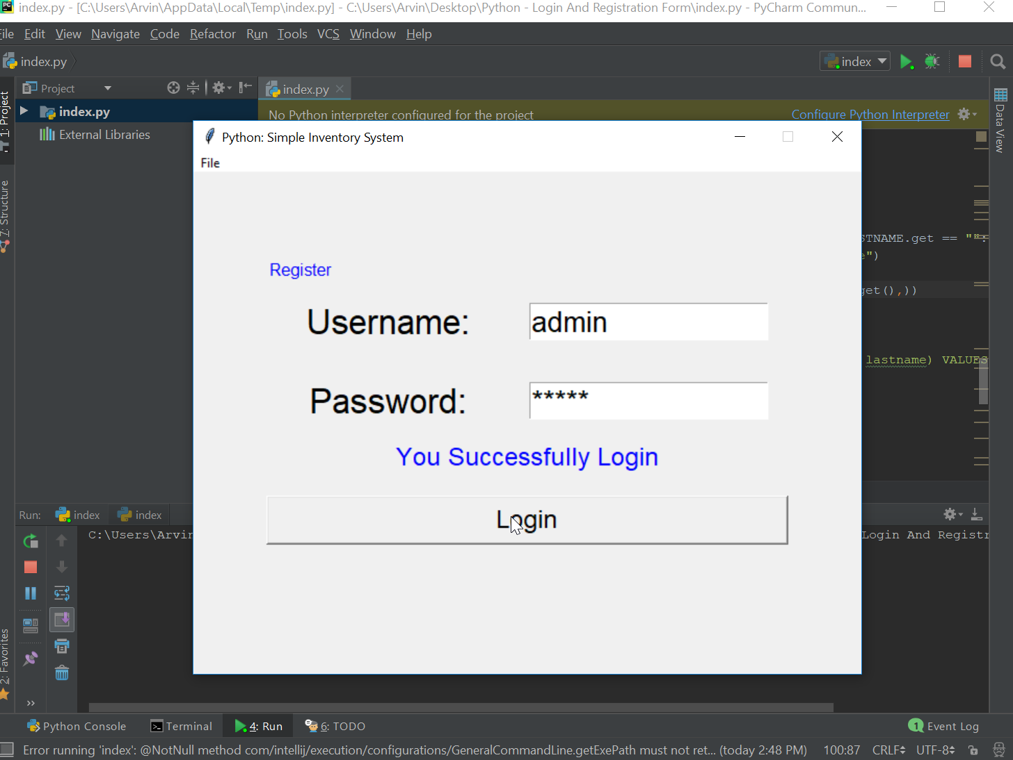
REGISTRATION
LOGIN PAGE

Slide 18
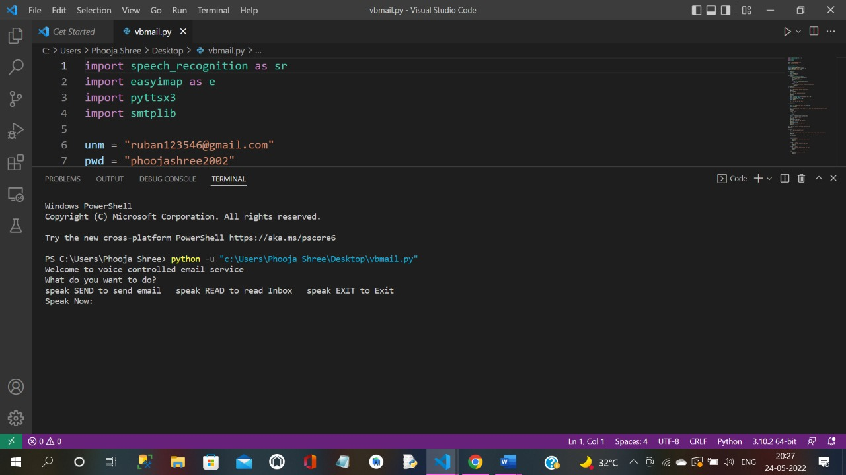
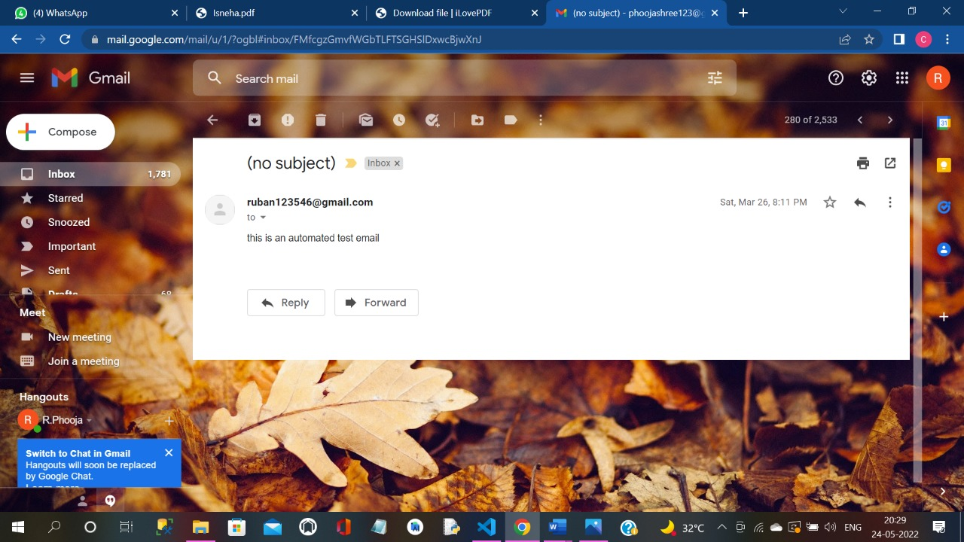
COMPOSE INBOX
Notes:
Now, that you have narrowed your topic, you will want to organize your research in a structure that works. There are some common organizational patterns based on the kind of research you are doing.
Organizational Structures:
Cause and Effect- this kind of structure is great for explaining the causes and effects of a topic
Compare and Contrast- in this pattern you highlight the similarities and differences of the topic
Explain process- this structure is great for outlining a series of steps to follow;
Definition- if you want to make sure your audience understands what something is using illustrations, meanings, clarifying misconceptions, you may want to use this structure
Classification- a common organizational structure is grouping like topics or facts from the research together. For instance, in the internet safety about social media apps, you may organize the research where you look at each social media app one at a time

Slide 19
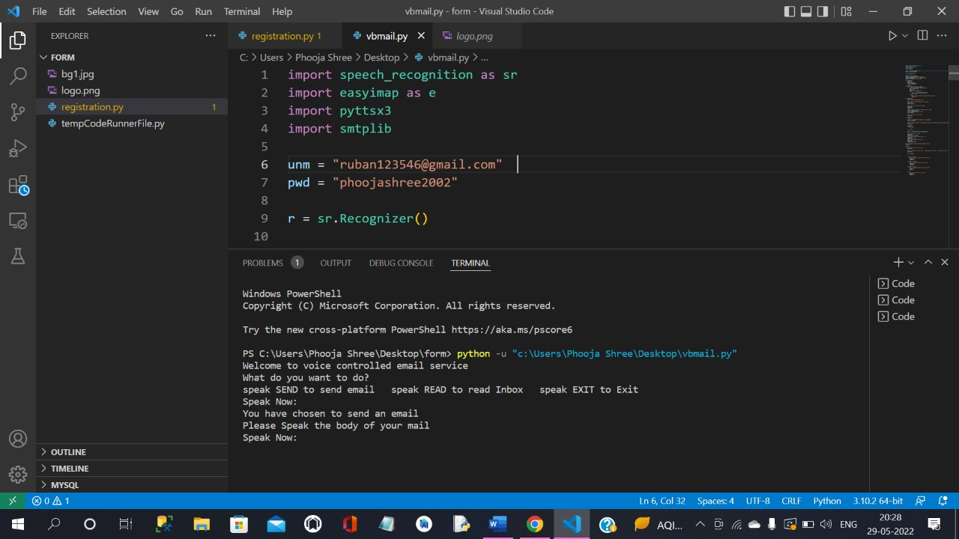
SCREENSHOTS

Slide 20
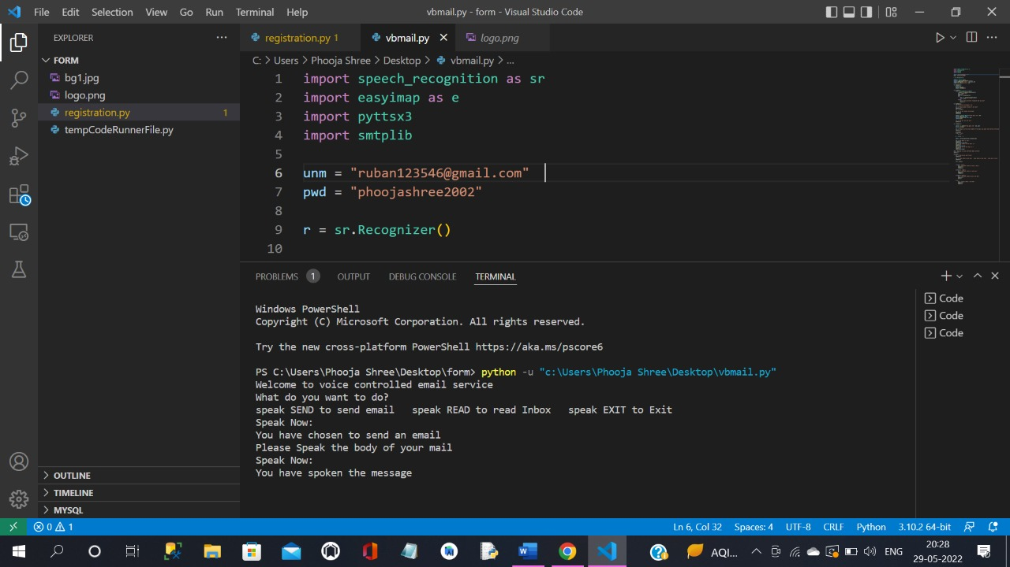

Slide 21
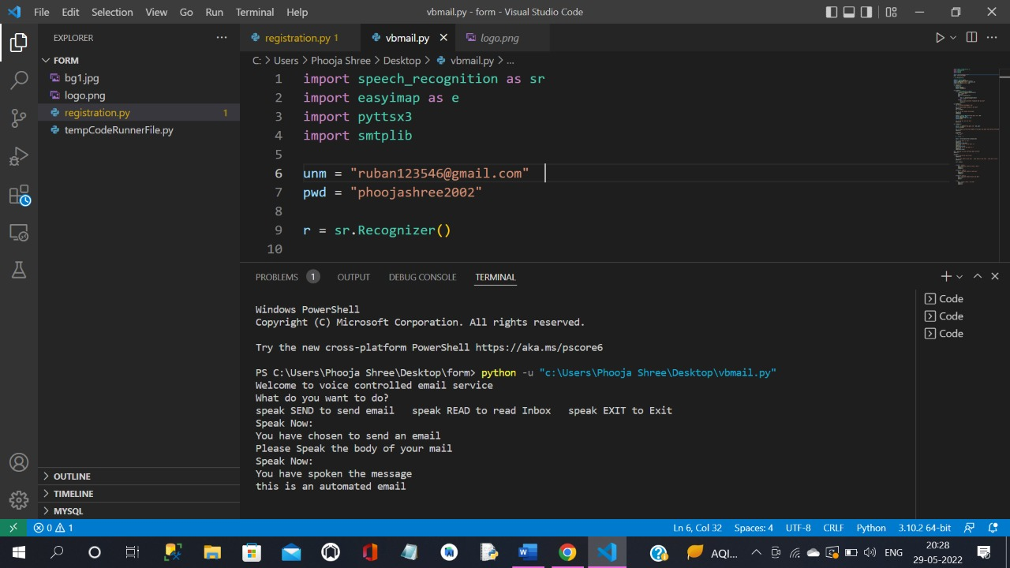

Slide 22
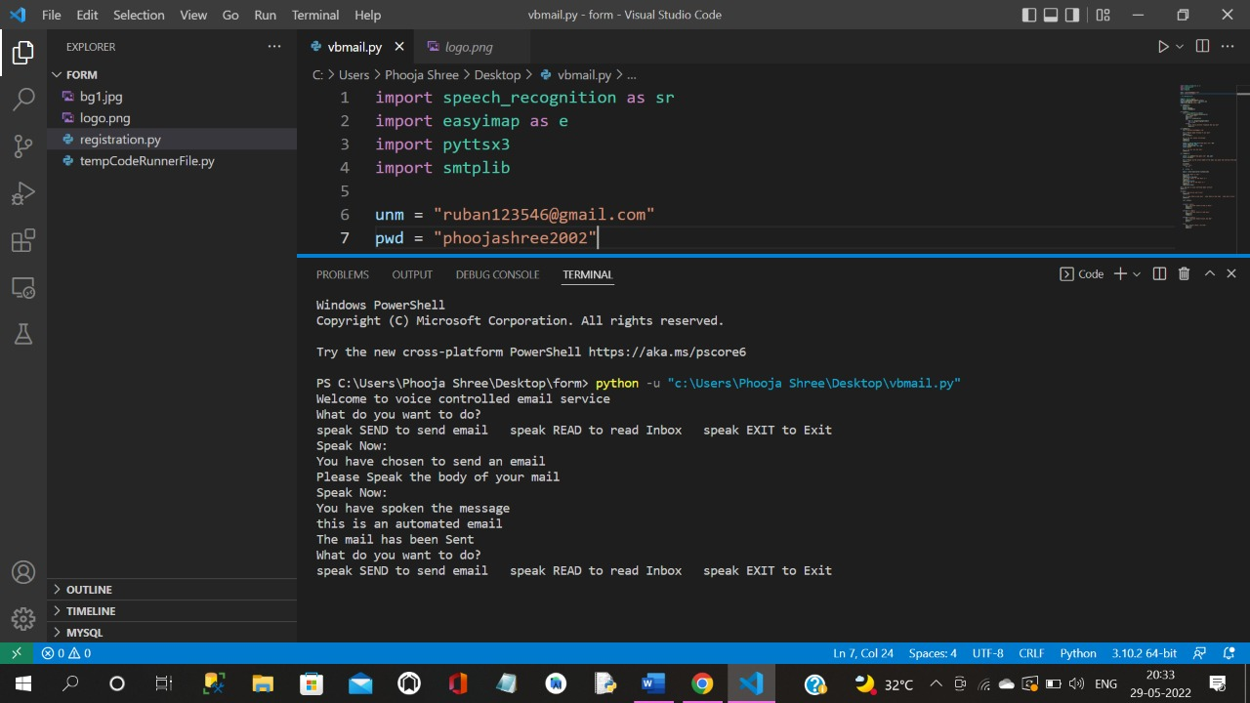

Slide 23
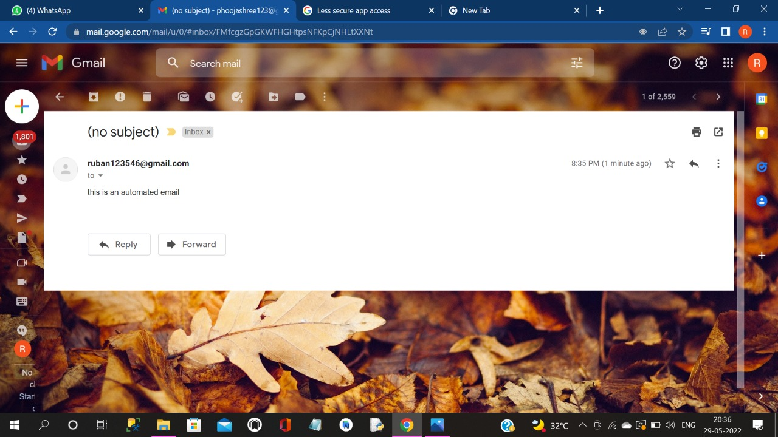

Slide 24
SYSTEM ANALYSIS
TRADITIONAL SYSTEM
PROGRESSIVE SYSTEM
The keyboard is mandatory in this system
Time-consuming process(Slow execution).
People who are blind are unable to engage with others or use the web based email system.
Because the system is based on voice command(google assistant) a keyboard is not required.
It is more efficient and faster than a typical system.
Both normal and disabled people can use the system(using voice commands).

Slide 25

CONCLUSION
This e-mail system can be used by any user of any age group with ease of access.
It has feature of speech to text as well as text to speech with speech reader which makes designed system to be handled by visually impaired person as well as blind person.
This system focuses more on user friendliness of all types of persons including regular persons, visually compromised people as well as illiterate.
Notes:
After you’ve done your research, it’s time to put your presentation together. The first step in the process is to introduce the topic. This is a great time to connect your topic to something that your audience can relate. In other words, why should they listen to all the information you will be sharing in your research presentation? What is in it for them? You may also want to include a graphic or image to grab their attention.
Feel free to duplicate this slide by right-clicking on this slide in the slides pane to the left and select Duplicate Slide.
The next step in your presentation is to state your claim or topic clearly. Your teacher may even call this your thesis. As you state your thesis, you may find that this layout is not the best layout for your claim or topic. You can change the layout by clicking the drop-down menu next to the Layout in the Slides menu section. You can choose Two Content, Comparison, or Picture with Caption. Note: A different layout might change the look of the icons on this page.
You will also want to state your facts. You have done the research now share some of the interesting facts with your audience. Facts do not have to be boring; you can communicate facts in a variety of ways by going to the Insert Tab. In the Insert tab you can:
Insert pictures from your computer or online.
Add a chart
Create some SmartArt
Insert a variety of icons to help your facts come to life. Note: You can change the color of the icons by selecting the icon and then click on the Format tab and then Graphics Fill. From there, you will choose a color from the list or choose More Fill Colors to give you more options.
Since this research presentation is a result of your hard work and searching, you want to make sure you support the claims or points in your presentation with facts from your research findings. Make sure you give the author proper credit for helping you share your ideas. If one of your sources has a video that is relevant to your topic, you can add the video as added support. Keep in mind the length of the video and the amount of time you have for your presentation. For a 5 minute speech, the video should be no longer than 30 seconds.
Questions to consider:
How will you state the author of the source?
Will you need to cite the source on the slide?
What are some ways you can engage your audience so they feel like they are a part of the presentation? Some ideas to consider is by taking a quick poll like: by a show of hands, how many of you think school uniforms are a way to cut down on bullying? Another suggestion is to have them hold up a certain number of fingers to see if they agree or disagree. Finally, you can share a story that the audience can relate to that makes them laugh.
After all the applause, your audience may have some questions. Be prepared to answer some of their questions by making a list of questions you think they might ask. You may also want to share the presentation with them by providing the link to your presentation, if they want more information.

Slide 26

REFERENCES
Harivans Pratap Singh, Aman Pratap Kushwaha, Aayushmaan, Harendra Singh, ”VOICE-BASED EMAIL SYSTEM ”- Department of Computer Science and Engineering ABESEC, Ghaziabad, U.P, India :7, July – 2021,IJISRT
Carmel Mary Belinda MJ, Rupavathy.N , Mahalakshmi N R, “A VOICE BASED TEXT MAIL SYSTEM FOR VISUALLY IMPAIRED”- February2018
Diksha Kumari, Nisha Pai, Parul Jha, Pratmika Nayak, “VOICE BASED EMAIL SYSTEM FOR BLINDS ”- April 2017,IEEE
Harsh D Shah, Amit Sundas, Shabnam Sharma, “CONTROLLING EMAIL SYSTEM USING AUDIO WITH SPEECH RECOGNITION AND TEXT TO SPEECH ”- 15 November 2021,IEEE

Slide 27
THANK YOU
Notes:
You can use this slide as your opening or closing slide. Should you choose to use it as a closing, make sure you review the main points of your presentation. One creative way to do that is by adding animations to the various graphics on a slide. This slide has 4 different graphics, and, when you view the slideshow, you will see that you can click to reveal the next graphic. Similarly, as you review the main topics in your presentation, you may want each point to show up when you are addressing that topic.
Add animation to images and graphics:
Select your image or graphic.
Click on the Animations tab.
Choose from the options. The animation for this slide is “Split”. The drop-down menu in the Animation section gives even more animations you can use.
If you have multiple graphics or images, you will see a number appear next to it that notes the order of the animations.
Note: You will want to choose the animations carefully. You do not want to make your audience dizzy from your presentation.

